Slide 1
Clustering and PCA
Assignment submitted by
Janarthanan B
jnvdasa@gmail.com

Slide 2
Introduction
In this section, we provide a synopsis of the problem statement and the solution approach we take to address the problem.

Slide 3
Problem Statement
Client: HELP International (an international humanitarian NGO committed to fighting poverty and providing the people of backward countries with basic amenities and relief during the time of disasters and natural calamities)
Business Question: How to use the $ 10 million funds raised effectively by choosing countries that are in the direst need of aid?
Dataset Available: Country data with 9different parameters: child mortality rate, net income per person, GDP per capita, inflation rate, life expectancy, fertility rate, import, export, spend on health, all of which are numeric variables (refer next slide for Data Dictionary)

Slide 4
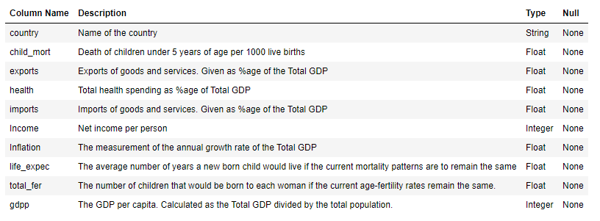
Data Dictionary

Slide 5
Solution Methodology
Step 1: Reading & understanding data
Step 2: Data Visualization.
Univariate (box plot, histogram)
Step 3: Identifying Outliers
(not to remove any outliers)
Step 4: Check for Multicollinearity.
Bivariate (pair plot, heat map)
Step 5: Principal Component Analysis
94.5% variance explained by 5 PCs.
Step 6: Creating the Clusters
K-Means Clustering
Step 7: Creating the Clusters
Hierarchical Clustering
Step 8: Analyzing the Clusters
Created 4 clusters using K-means
Step 9: Recommendations

Slide 6
Exploratory Data Analysis
In this section, we explore the data with an objective to understand the data, address data quality issues (if any), visualize the data to get more insights, identify outliers or scaling issues in the data and to see how the variables are correlated with each other.

Slide 7
Reading and Understanding the Data
Read the data from the csv file and load it into Python Data frame
Check for any data quality issues and address them.
Identify the outliers. Decide on how to treat the outliers.
Univariate Analysis to get insight into each variable & its distribution.
Bivariate Analysis to study the correlations between variables.

Slide 8
Data Quality Check
S.No. | Description | Yes | No
1 | Any unnecessary rows: blank rows, header, footer, summary, total, subtotal? |  | ✓
2 | Any issues with columns: missing or inconsistent column name, unwanted column etc. |  | ✓
3 | Are there any missing values or null values? |  | ✓
 | Note: If there are missing values, we have two options: drop the row or column or impute the missing values (try other data sources, or derive the values or use business judgment)
4 | Are there any issues with the data types of the columns? |  | ✓
5 | Is there a need to standardize precision for better presentation of data? |  | ✓
6 | Are there any outliers? Is there a need to remain outliers? (Refer next slide) |  | ✓
7 | Are the observations under each variable have any variation in scale? |  | ✓

Slide 9
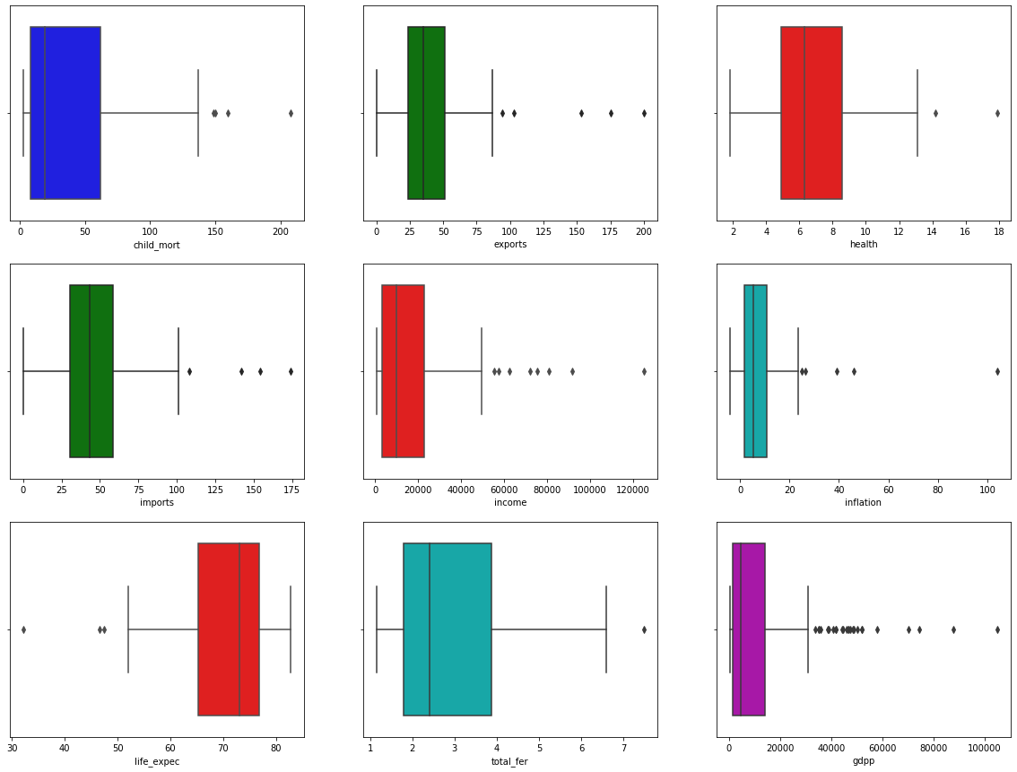
Univariate Analysis
Box and Whiskers plots are ideal for studying the data distribution and checking for any outliers. The dots beyond the whiskers indicate the outliers. There are a quite a lot of outliers in the variables income and gdpp. The line in the middle of the box is an indicator of any skewness in the data.

Slide 10
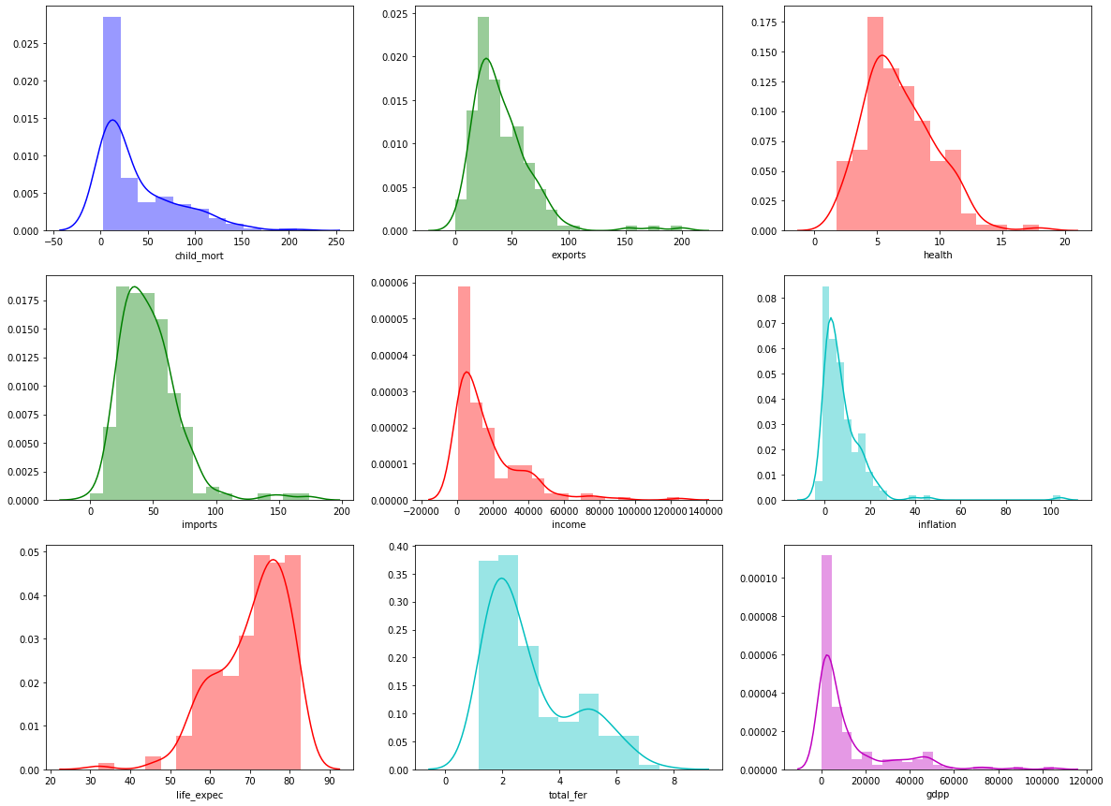
Univariate Analysis - contd.
Histogram and Distribution curves can also be used for analysing the individual numeric variables in the data to study the distribution and skewness. We do not get much information about the outliers here.

Slide 11
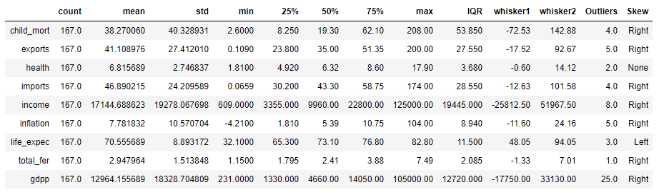
Identifying Outliers
There are not many outliers, except for the variables income and gdpp. However, removing the outliers may result in some countries missing out the chance of getting the funds. So we have decided not to remove any outliers from the data.

Slide 12
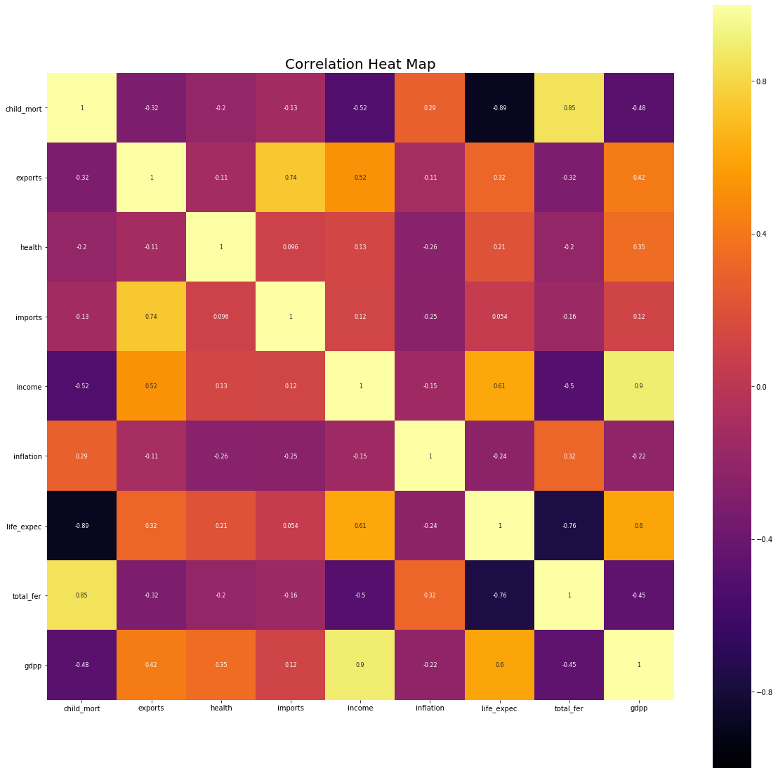
Bivariate Analysis
We see that many of the variables are strongly correlated. (1) income and gdpp has strong positive correlation; (2) child mortality and fertility rate has strong positive correlation (3) both child mortality and fertility rate has strong negative correlation with life expectancy and (4) imports and exports has strong positive correlation.

Slide 13
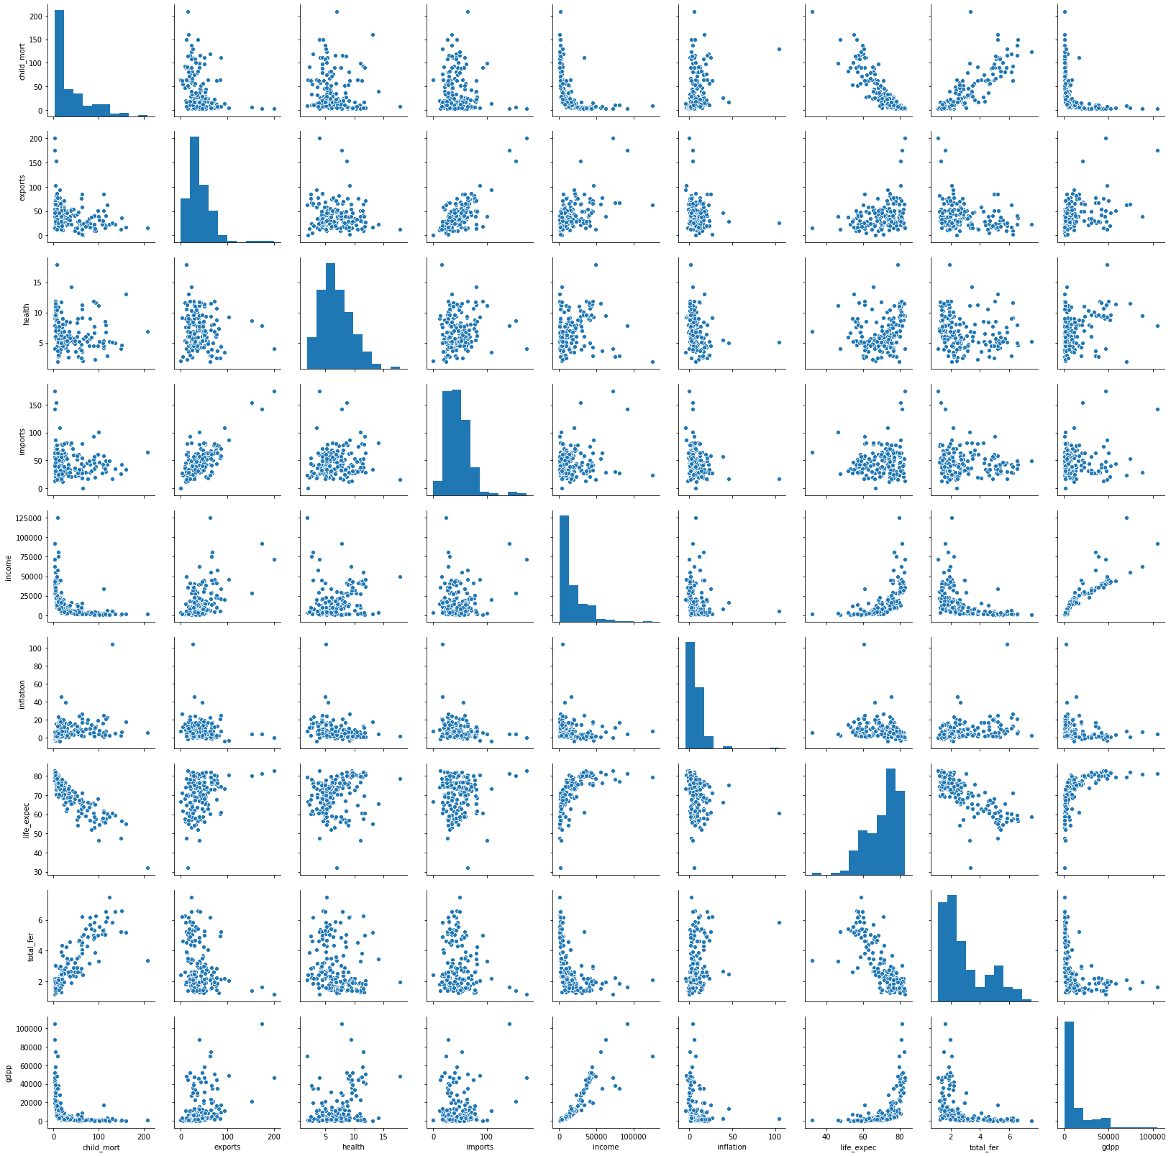
Bivariate Analysis
Multicollinearity refers to a situation in which two or more independent variables are highly linearly related. From the heat map in previous slide and the scatter plot it is evident that we have variables that are correlated with each other. With PCA (principal component analysis), we can avoid the problem of multicollinearity. The principal components are linear combinations of the original variables in such a way as to explain the variance without losing information (i.e. without the need for dropping any columns)

Slide 14
Principal Component Analysis
In this section, we proceed with the PCA for dimensionality reduction to arrive at a fewer non correlated variables that are linear combination of the original variables and preserve maximum information.

Slide 15
Standardization of the Variables
The 9 numeric variables are in different scales.
It is important to standardize them before performing PCA.
Standardization is a method which scales the data in such a way that the mean = 0 and the standard deviation = 1.
We do this using StandardScaler imported from sklearn.preprocessing

Slide 16
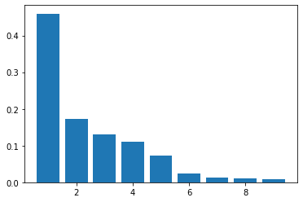
PCA explained variance ratio
If we apply PCA on n variables it creates a maximum of n variables and each principal component explains certain variance in the data. Here we have 9 principal components out of which we see that 5 of them explain almost 95% of the variance in the data.

Slide 17
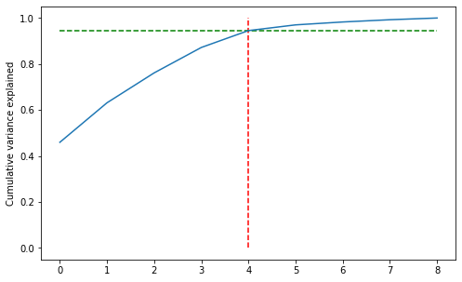
Scree Plot
94.5% of the variance is explained by 5 principal components
Note: a scree plot is a line plot of the eigenvalues of principal components in an analysis.

Slide 18
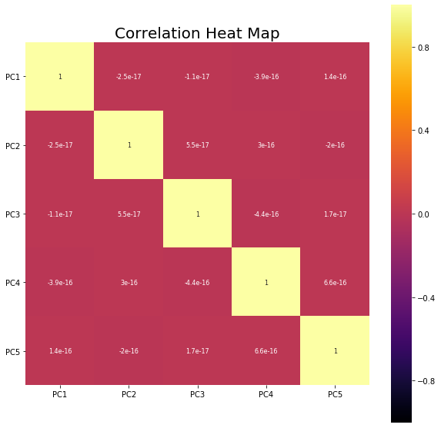
Non correlated components
There is no multi collinearity.
The principal components are not correlated with each other.
The principal components are linear combination of the original variables. Thus, we also preserve most of the information, as we have not dropped any columns.

Slide 19
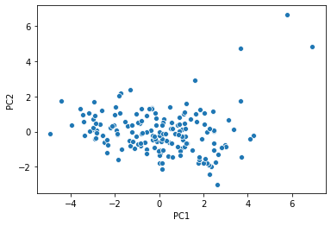
Scatter Plot - PC1 vs. PC2
The first two components that explain most of the variance are plotted.
Hopkins statistics for this data is greater than 0.7. The data has good tendency to form clusters.

Slide 20
Clustering
In this section, we apply the clustering algorithms:
K-means clustering and Hierarchical clustering.

Slide 21
K-means Clustering
Clustering is an unsupervised machine learning technique, where we try to find patterns based on similarities in the data.
The dataset is divided into groups called clusters such that the data points in each cluster are as similar (or close) as possible to one another (intra-cluster homogeneity) and the data points in different groups are as dissimilar as possible from each other (inter-cluster heterogeneity).
K-means algorithm is an iterative algorithm that tries to partition the dataset into K distinct non-overlapping groups (clusters) where each data point belongs to only one cluster.

Slide 22
Steps in K-means Clustering
Initialization (randomly choose k points as centroids)
Assignment (assign the different points to the nearest centroid) and
Optimization (compute the centroid as an average of the points in the cluster). The assignment and optimization steps are repeated till the solution converges (i.e. the centroid do not change further)
However, the first challenge is to decide how many clusters to be formed i.e. what is the value of k?

Slide 23
Finding the optimal value for K
Elbow Curve: For different values of k (2, 3, 4 .... 10 and so on) we apply the algorithm and then compute the sum of the squared distances (SSD) of the points to their closest cluster center. We plot these SSD against the number of clusters, which gives us the elbow curve. We select the point at which the marginal decrease (or the rate of drop) in the SSD value starts to diminish, which means that adding a new cluster is not adding any value the model.
Silhouette score: The silhouette of a data point is a measure of how similar it is to data points within its cluster and how dissimilar it is matched to the data points in other clusters. Let q be the mean of the intra-cluster distance of a data point to all the points in its own cluster and p be the mean of the inter-cluster distance of the data point to the points in the nearest cluster that the data point is not part of. The silhouette score is computed as (p - q) / max(p, q). The value of this score lies between 1 and -1. A score closer to 1 indicates that the point is very similar to other data points in its own cluster, whereas a score closer to -1 indicates intra-cluster dissimilarity.

Slide 24
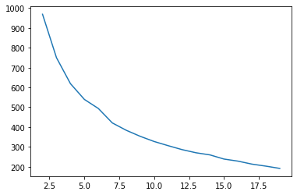
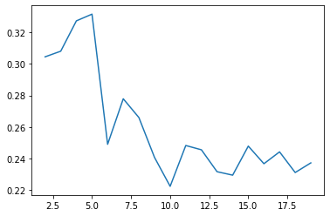
Finding the optimal value for K
Elbow Curve
Silhouette Analysis
Based on the above analysis we can consider the optimum number of clusters to be 4 or 5. But when we do with 5 clusters, there is only one country getting into a fifth cluster. So we will choose to create only 4 clusters.

Slide 25
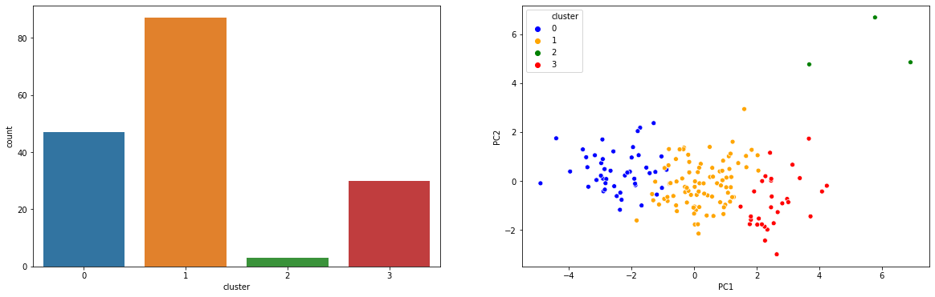
Creating the Clusters
Cluster 0: Blue Dots - Under Developed Countries
Cluster 1: Orange Dots - Developing Countries (China, Russia, Malaysia, India and so on)
Cluster 2: Green Dots - Some of the outliers (Luxembourg, Malta, Singapore)
Cluster 3: Red Dots - Developed Countries (Norway, Switzerland, USA, Germany, Ireland, Australia etc.)

Slide 26
Hierarchical Clustering
In Hierarchical Clustering, we use the agglomerative approach to start with as many clusters as there are data points and then start merging the clusters that are closest to each other. There are three methods to compute the distance between two clusters.
Single Linkage: The distance is computed as the shortest distance between points in the two clusters. If we represent the points in cluster r as x_{r} and the points in cluster s as x_{s}, then in single linkage we compute the distance between the clusters as min(D(x_{ri}, x_{sj})).
Complete Linkage: The distance is computed as the longest distance between points in the two clusters. If we represent the points in cluster r as x_{r} and the points in cluster s as x_{s}, then in single linkage we compute the distance between the clusters as max(D(x_{ri}, x_{sj}))
Dendrograms produced using single linkage may not be structured properly. So to get a proper tree-like structure we use complete linkage or average linkage.

Slide 27
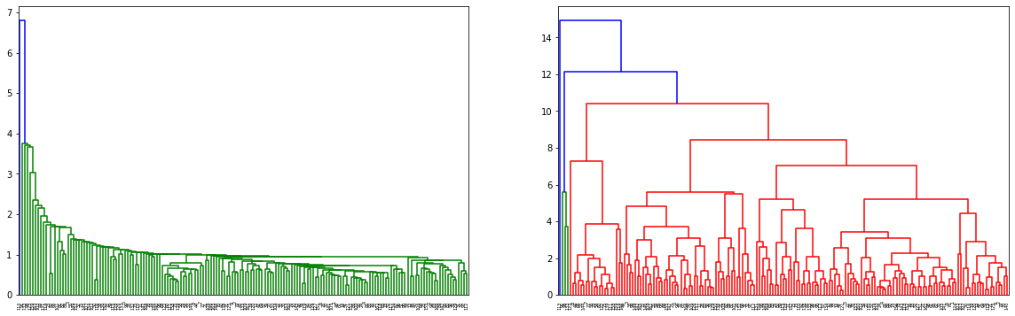
Dendrograms
Single Linkage
Complete Linkage

Slide 28
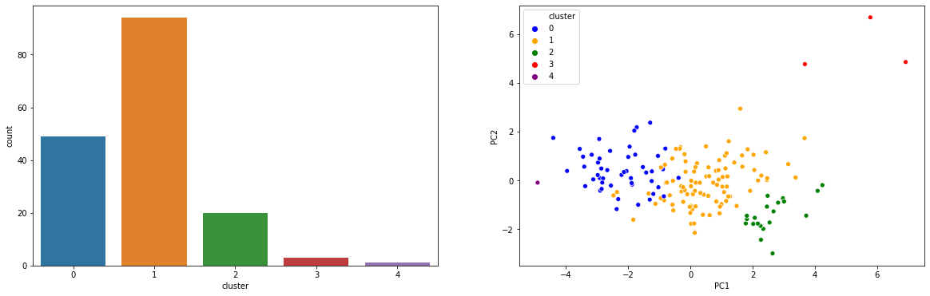
Creating the Clusters
We got 4 clusters using hierarchical clustering which varies from the clustering given by K-means algorithm. But it produces better and more intuitive results compared to the k-means algorithm. However, for further analysis we will go with the clustering given by K-means.

Slide 29
Cluster Analysis and Recommendations
In this final and concluding section, we present a summary of our analysis and our recommendations on which are the countries that are in dire need for funding.

Slide 30
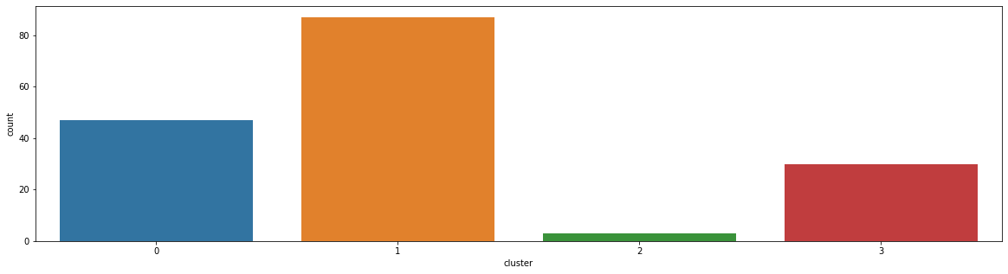
Clusters
We created the clusters using the principal components. Now it is time to analyze the clusters thus formed using the original variables to identify the countries which you finally want to select.

Slide 31
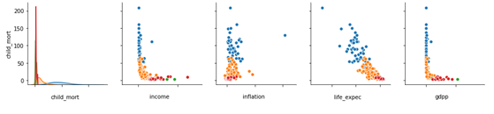
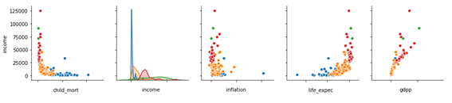
Visualizing the Clusters

Slide 32
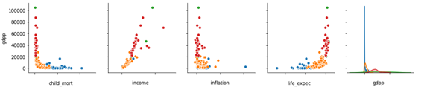
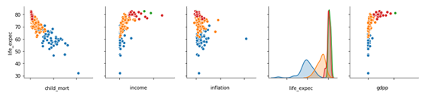
Visualizing the Clusters

Slide 33
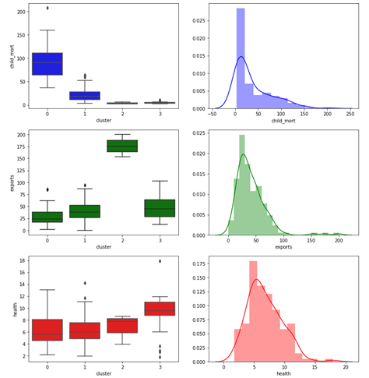
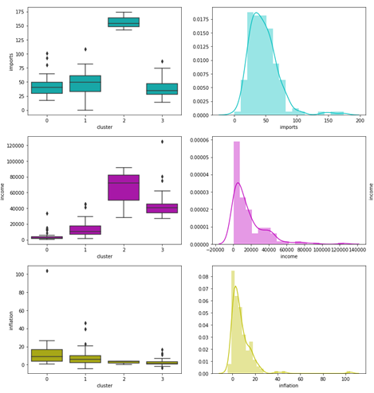

Slide 34
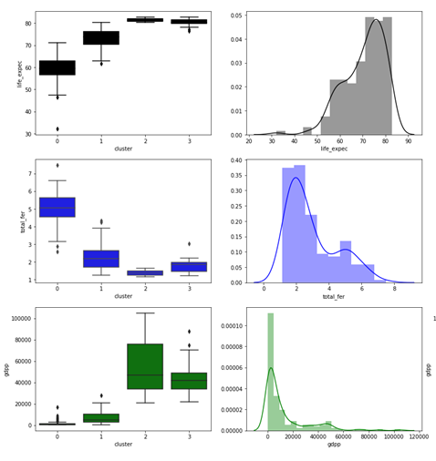
The box plots and distribution plots show how the data is distributed across the different clusters. The conclusions are presented in the next slide.

Slide 35
Cluster 0 - Under Developed Countries
From the above visualizations, we can see that, compared to other countries, the countries in cluster 0 have high child mortality rate, low life expectancy, low income and low gdpp, and high inflation rate. This is definitely a sign that these countries deserve more support and are in dire need for aid. These are under-developed countries.
Since most of the parameters are expressed in terms of the gdpp of the country, we will consider gdpp to rank the countries in cluster 0 to come up with the list of most deserving country. As we have seen earlier, the income is also strongly correlated with gdpp.

Slide 36
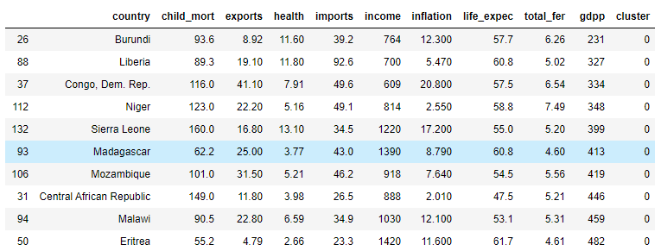
Recommendation
The countries which are having the dire need for funding aid are:
Burundi
Liberia
Congo, Dem. Rep.
Niger
Sierra Leone
Madagascar
Mozambique
Central African Republic
Malawi
Eritrea

Slide 37
Thank You
Submitted by: Janarthanan B

